Slide 1

Checkers AI Game
Ali Suleiman
amsuleim@umich.edu
CIS 553
Software Engineering

Slide 2
Agenda
Purpose
Requirements
Design
Project Metrics
Demo

Slide 3
Purpose
The purpose of this project is to build a checkers game that you can play against the computer.

Slide 4
Requirements
Regular men on the board, can only move forward to unoccupied diagonal pieces.
Pieces can only move on the black squares.
Jumps have to be taken when they are available, and chains of jumps must be completed in a single turn.
Regular men cannot jump backwards.
Kings have the ability to move and jump in all 4 directions, but they still can only move a single space during a turn, and must make linked jumps to completion just as there minor counterparts.
When a piece is crowned, the players turn ends even if a potential opportunity is created upon crowning.
When one player is unable to move, due to being block, or losing all his pieces, then he loses.

Slide 5
High level Design
User Interface
Move Entry State Machine
User Interface State Machine

Slide 6
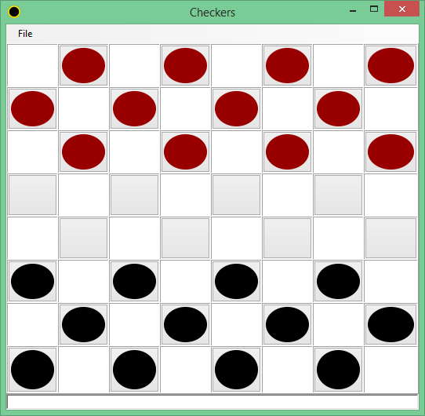
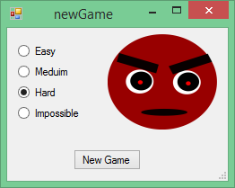
User Interface

Slide 9
Project Metrics
Functions: 32
Windows: 4
Unit Tests 39
UAT Tests: 5
Save Game
Load Game
Win
Lose
New Game

Slide 10
Demo
https://drive.google.com/open?id=0Bz8f-mEPaKoZVm5WY0ZXTFM5LXM

